Slide 1
Project Explanation
Car Service Booking System
Kanakarathne Kasun Madhawa
M24W0633

Slide 2
Overview
The Car Service Booking System is an application designed to manage the process of booking car services of car service chain company. It provides functionalities for both customers and staff to interact with the system, allowing customers to create profiles, book services, view and cancel bookings, and update their information. Staff members, on the other hand, have access to additional features like viewing all bookings and exporting booking data. The system is built using C++ and object-oriented programming (OOP) principles.

Slide 3

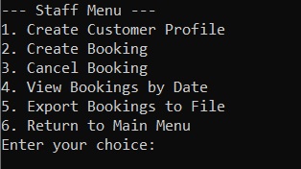
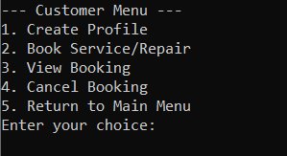
Users
Staff
Customer

Slide 4

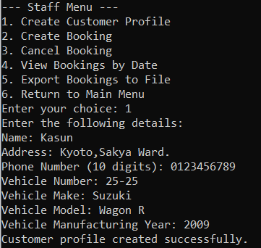
System Features
Features for Staff:
•Staff Login: Staff members must log in using valid credentials before accessing staff functions.
Profile Creation and Editing: staff can create, and edit profiles.
View Bookings: Staff can view all bookings for a specific branch on a specific date, helping them manage customer appointments and available resources.
Export Bookings: All booking information can be exported into a text file for record-keeping or further analysis.

Slide 5
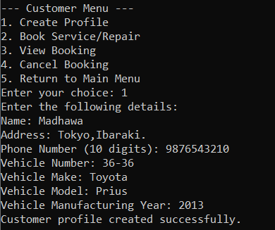
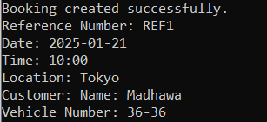
System Features
Features for Customers:
•Profile Creation and Editing: Customers can create and edit their profiles, making it easier for them to manage their information and ensure accurate service bookings.
•Booking and Cancelling Services: Customers can book services by selecting a time in between 9:00-14:00 time period. They can also cancel bookings when necessary.
View Bookings: Customers can view a list of their service appointments.

Slide 6
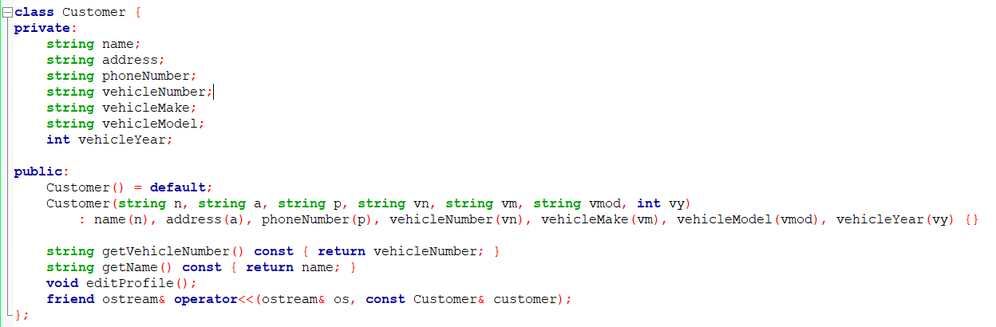
OOP approch in the system
Customer Class
The Customer class represents a customer and their vehicle. It has the following attributes:
Private Attributes
name: Customer's full name
address: Customer's address
phoneNumber: Customer's contact number
vehicleNumber: Unique identifier for the customer's vehicle
vehicleMake: Brand of the vehicle
vehicleModel: Model of the vehicle
vehicleYear: Manufacturing year of the vehicle
Public Methods
Default Constructor: Allows creation of a Customer object without initializing its members
Parameterized Constructor: Initializes all member variables with provided values
getVehicleNumber(): Returns the vehicle number
getName(): Returns the customer's name
editProfile(): Allows modification of customer details (implementation not shown in the provided code)
operator<<: Overloaded stream insertion operator for easy output of Customer objects

Slide 7
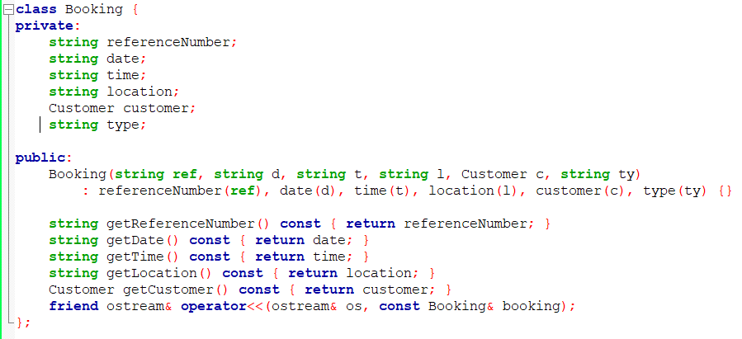
Booking Class
The Booking class represents a service booking made by a customer. It has the following attributes:
Private Attributes
referenceNumber: A unique string identifier for each booking, generated using the format "REF" followed by a number (e.g., "REF1", "REF2").
date: Stores the appointment date as a string in "YYYY-MM-DD" format. The system validates this to ensure it's a future date and follows the correct format.
time: Represents the appointment time slot as a string in "HH:MM" format. It's restricted to between 09:00 and 14:00, with validation to ensure it falls within this range.
location: A string indicating the service center location. The system offers predefined locations like Tokyo, Osaka, Kyoto, Nara, and Chiba.
customer: An object of the Customer class, containing all relevant information about the customer making the booking, including their name, contact details, and vehicle information.
Public Methods
Constructor: Initializes all member variables with provided values
getReferenceNumber(): Returns the booking's reference number
getDate(): Returns the booking date
getTime(): Returns the booking time
getLocation(): Returns the service location
getCustomer(): Returns the Customer object associated with the booking
operator<<: A friend function that overloads the stream insertion operator for easy output of Booking objects

Slide 8
BookingSystem class
This class encapsulates the main functionality of the booking system, providing methods for managing customers, bookings, and staff operations while ensuring data validation and security through authentication.
Private Attributes
customers: A vector storing Customer objects
bookings: A vector storing Booking objects
locations: A constant vector of available service locations
staffCredentials: A constant vector of staff username-password pairs for authentication
Private Methods
isValidDate: Validates the date format (YYYY-MM-DD) and ensures it's not before 2025
isValidTime: Checks if the given time is within the 09:00-14:00 range
Public Methods
isValidPhoneNumber: Validates 10-digit phone numbers
authenticateStff: Verifies staff credentials
createCustomerProfile: Creates a new customer profile
findCustomerByVehicle: Locates a customer using their vehicle number
createBooking: Creates a new service booking
viewBooking: Displays booking details
cancelBooking: Removes an existing booking
staffViewBookingsByDate: Allows staff to view bookings for a specific date and location
exportBookingsToFile: Saves all bookings to a file
generateReferenceNumber: Creates a unique reference number for each booking

Slide 9
UserInterface class
This class acts as a bridge between the user and the BookingSystem, providing separate interfaces for staff and customers while also maintaining a log of staff activities for auditing purposes.
Private Members
bookingSystem: An instance of the BookingSystem class, allowing the interface to interact with the core functionality of the booking system.
Private Methods
logStaffActivity: A method that logs staff actions to a file named "staff_activity.log". It records the timestamp, username, and action performed.
Public Methods
mainMenu: Displays the main menu of the application.
staffMenu: Handles the staff-specific menu and operations.
customerMenu: Manages the customer-specific menu and interactions.

Slide 10
Potential Implementation in to the system
Enhance the data validation
Code Refactoring for Modularization
Advanced Search and Filter Functionality - when the number of customers and bookings increases, searching through large lists may become slow.
implement a GUI.
Include customer Feedback Feature.

Slide 11
Conclusion
The Car Service Booking System is an easy-to-use tool that helps customers and staff manage car service bookings. It offers simple interfaces for both users, making the operation of car service centers run smoothly.
Program Demonstration.....
Thank you !
Kanakarathne Kasun Madhawa
M24W0633

